Slide 1
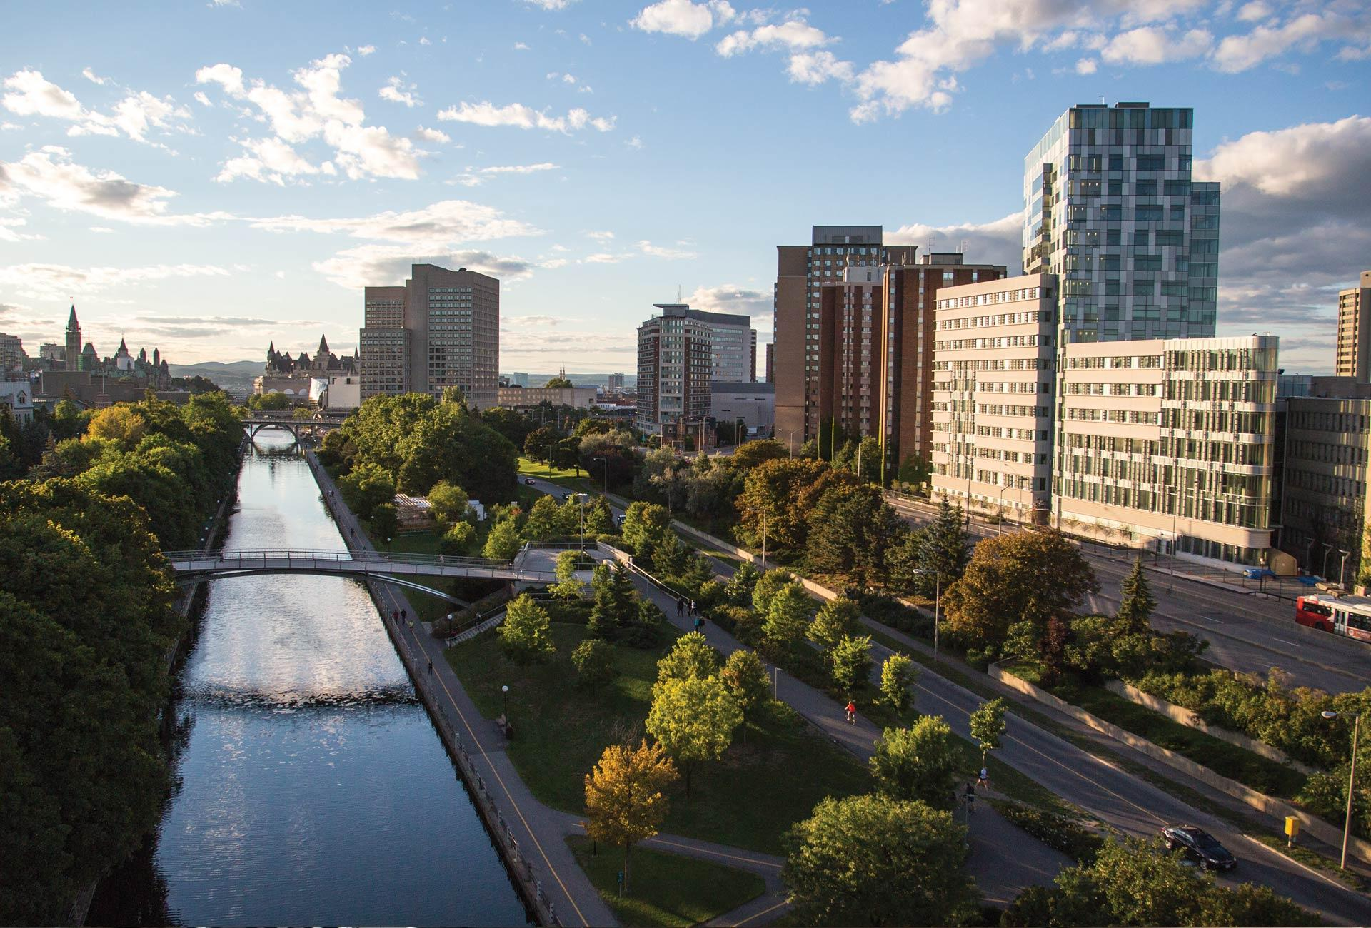

Can LLMs Solve Brainteasers?
Alex Gagnon, John Joseph Zagariah Daniel, Kartik Banga
uOttawa.ca
Notes:
PAGE COUVERTURE (option 2)
REMARQUE : À lire avant d’utiliser le gabarit
Les éléments suivants du gabarit ne peuvent pas être modifiés : • En-tête institutionnel grenat (Université d’Ottawa | University of Ottawa) • Pied de page institutionnel comprenant la bande grise et grenat ainsi que le logo
Les éléments suivants du gabarit peuvent être modifiés : • L’adresse Web uOttawa.ca dans le pied de page peut être personnalisée afin de répondre aux besoins de l’utilisateur et le nom du document peut être inséré à la droite de l’URL si nécessaire. Vous pouvez simplement taper l’adresse Web désirée dans la boîte appropriée
• La photo ou l’image de fond peut être remplacée par celle de votre choix
COVER PAGE (option 2)
NOTE: Read before using template
The following elements of the template must remain untouched and cannot be modified:
• Corporate (Université d'Ottawa | University of Ottawa) garnet header
• Corporate uOttawa footer including the grey/garnet stripe and logo
The following elements of the template may be customized:
• You may include the uOttawa.ca URL of your choice in the footer, and insert the name of the document to the right of the URL, if needed
• The URL can be customized to a specific URL by following these simple steps: On the PowerPoint View tab, in the Master Views group, select Slide Master. Select the third slide on the left side panel, and type in the desired URL on the slide • The photo or background image may be replaced by the photo or background image of your choice

Slide 2
Introduction
NLP is highly popular today, with tech giants like OpenAI, Google, Meta, Microsoft, etc., frequently releasing LLM models to dominate market share. However, LLMs generally struggle with applying common sense or unconventional thinking.
Brainteasers require such thinking as they are riddles in which the answer cannot be determined solely by rationality, logic, and rules.
For example: “How could a cowboy ride into town on Friday, stay two nights, and ride out on Wednesday” is a brain teaser whose solution is “Friday and Wednesday are the names of two horses”.

Slide 3
Potential Approach 1 - Fine tuning
Models like BERT, ALBERT, Roberta, XLNet, etc. support AutoModelForMultipleChoice, which means they are pre-trained for MCQ's and hence are trained to understand their structure.
Create pairs of question/option for each available option, preprocess them with tokenization, pad the sentences to a specific length, and train the model for several epochs to answer brain teasers specifically.
However, these are generally smaller models, and as such may not have the capacity to understand common sense knowledge-based riddles.
https://huggingface.co/docs/transformers/main/en/tasks/multiple_choice#multiple-choice

Slide 4
Potential Approach 2 - Likelihood
Similar to the previous approach the MCQ is split into 4 question/option pairs, but then an autoregressive model that supports AutoModelForCausalLM like GPT-2 is used to compute the likelihood that the model would have generated the option given the question.
The option with the highest likelihood is the models’ choice.
No fine-tuning required. Can use modern, large LLMs that may understand common-sense knowledge.
https://huggingface.co/docs/transformers/main/en/perplexity#example-calculating-perplexity-with-gpt-2-in--transformers

Slide 5
Potential Approach 3 - Prompt Engineering
Use chat based approach: simply prompt the model with the question and extract the answer choice from the response.
No fine-tuning required. Can use modern, large LLMs that may understand common-sense knowledge.
However, answers can differ drastically depending on the prompt, and it may be difficult to parse the answer if the model is too “chatty”.
Need to evaluate different prompting strategies.
https://huggingface.co/docs/transformers/main/en/llm_tutorial

Slide 6
Project Summary
The topic of our paper is to evaluate different Prompt Engineering strategies* such as Chain of Thought or Prompt Generation on two modern LLMs (Gemma and Llama 2) to compare their ability to answer brain teasers.
If time allows, we would also like to investigate more involved strategies such as Retrieval Augmented Generation (RAG)* or Mixture of Experts (MOE)
Code will be in Python using common NLP packages such as “transformers” and models available from HuggingFace hub.
* Examples of strategies
** We have not yet investigated sources of additional context for common-sense knowledge for RAG

Slide 7
Methodology
The dataset and evaluation is from SemEval 2024 Task 9 - Brainteaser.
It consists of two categories of puzzles:
Sentence Puzzle: Sentence-type brain teaser where the puzzle defying commonsense is centered on sentence snippets.
Word Puzzle: Word-type brain teaser where the answer violates the default meaning of the word and focuses on the letter composition of the target question
Puzzles were sourced from the internet, and then adversarial versions were created to avoid model memorization from their training data
Semantic Reconstruction rephrases the original question without changing the correct answer and the distractors.
Context Reconstruction keeps the original reasoning path but changes both the question and the answer to describe a new situational context.
Evaluation is based on answer accuracy

Slide 8
Progress to date
Convert source data into HuggingFace datasets - done
Create code to test the three approaches as a baseline - done
Investigate prompting strategies on a single model - in progress
Compare prompting strategies between the two models - to do
Report results - to do

Slide 9
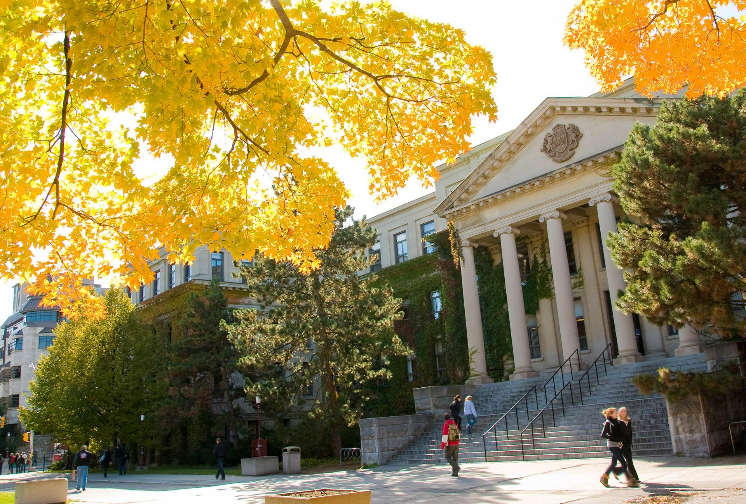
Thank you!
uOttawa.ca
Notes:
PAGE COUVERTURE (option 1) REMARQUE : À lire avant d’utiliser le gabarit
Les éléments suivants du gabarit ne peuvent pas être modifiés : • En-tête institutionnel grenat (Université d’Ottawa | University of Ottawa) • Pied de page institutionnel comprenant la bande grise et grenat ainsi que le logo
Les éléments suivants du gabarit peuvent être modifiés : • L’adresse Web uOttawa.ca dans le pied de page peut être personnalisée afin de répondre aux besoins de l’utilisateur et le nom du document peut être inséré à la droite de l’URL si nécessaire. Vous pouvez simplement taper l’adresse Web désirée dans la boîte appropriée
• La photo ou l’image de fond peut être remplacée par celle de votre choix
COVER PAGE (option 1)
NOTE: Read before using template
The following elements of the template must remain untouched and cannot be modified:
• Corporate (Université d'Ottawa | University of Ottawa) garnet header
• Corporate uOttawa footer including the grey/garnet stripe and logo
The following elements of the template may be customized:
• You may include the uOttawa.ca URL of your choice in the footer, and insert the name of the document to the right of the URL, if needed
• The URL can be customized to a specific URL by following these simple steps: On the PowerPoint View tab, in the Master Views group, select Slide Master. Select the third slide on the left side panel, and type in the desired URL on the slide • The photo or background image may be replaced by the photo or background image of your choice

